Slide 1
Classical-Quantum Hybrid Convolutional Neural Network
Quantum Ant

Slide 2
INDEX
1. Problem 1
2. Implementation of hybrid neural network
3. Result of experiment
4. Conclusion

Slide 3
TEXT
Problem 1: Classical-Quantum Hybrid Convolutional Neural Network
Implement quanvolutional neural network proposed in Ref. [7] and reproduce the MNIST data classification results therein.
Use qubit encoding Ry(x)|0> to load a classical pixel value x as an input to the quantum circuit.
Compare the classification performance of the quanvolutional neural network determined by various quantum circuit templates provided in Ref. [9]. Rather than naively trying out all templates, try only some of them (e.g. four or five). Justify your choice.
Test the classification performance of the hybrid machine learning algorithm with respect to the number of iterative applications of independent quanvolutional filters.

Slide 4
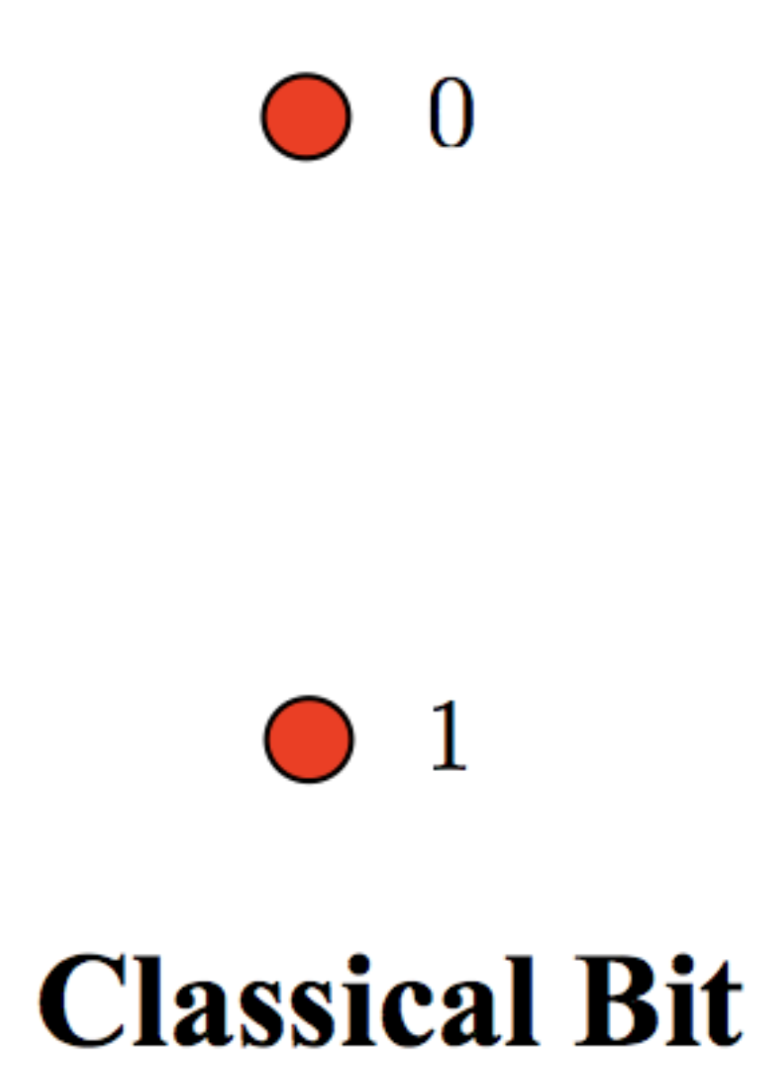
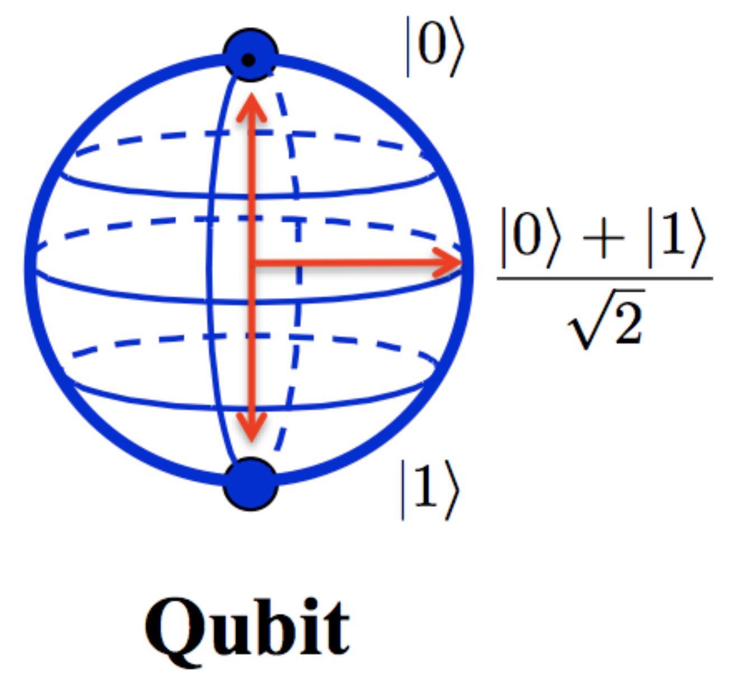
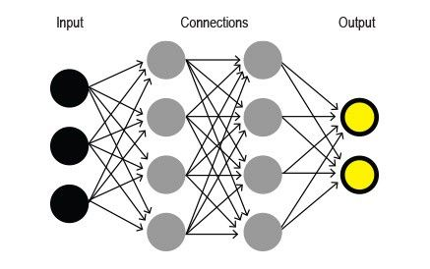
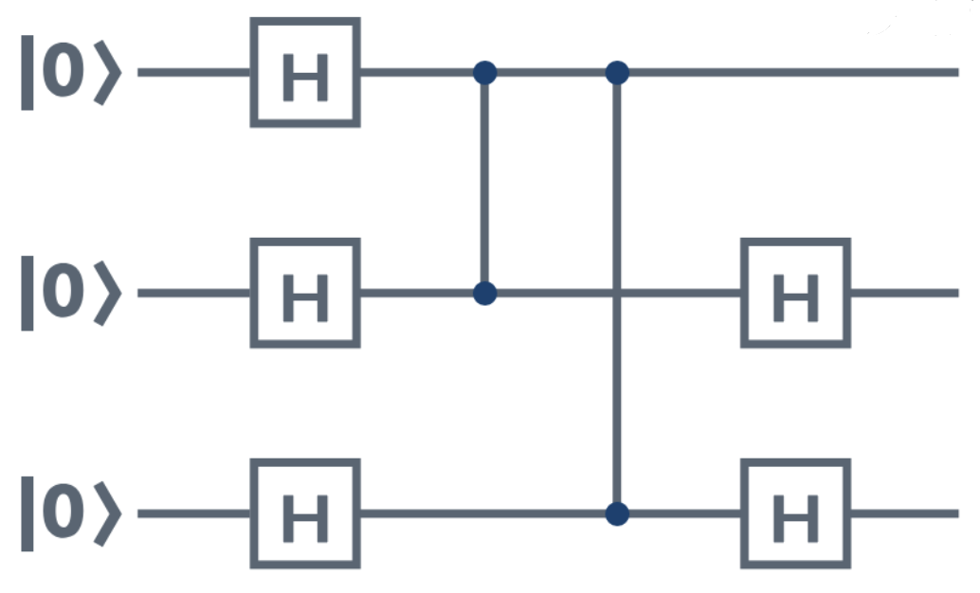
TEXT
Classical-Quantum Hybrid Convolutional Neural Network
Load
Classic Data
Quantum Data
Quantum
Circuit
Classic Neural Network
loss
Calculation
Encoding
Parameter update

Slide 5
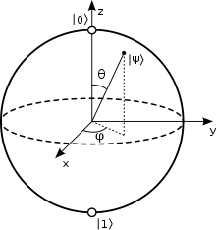
TEXT
Data encoding
Process - classic data → theta → quantum filter
Theta setting and rotation calculation based on the threshold - Combine the number of possible cases with uncertainty - Encoding as quantum data
Set threshold = 127 - MNIST dataset : Black and white image composed of white or black pixel values
- Set it to the middle value of the pixel values from 0 to 255. Below threshold → 0 Above threshold → pi (3.141592…)
After setting the value obtained through classic data as theta, it is used for quantum filter
Rotation by theta in the original state

Slide 6
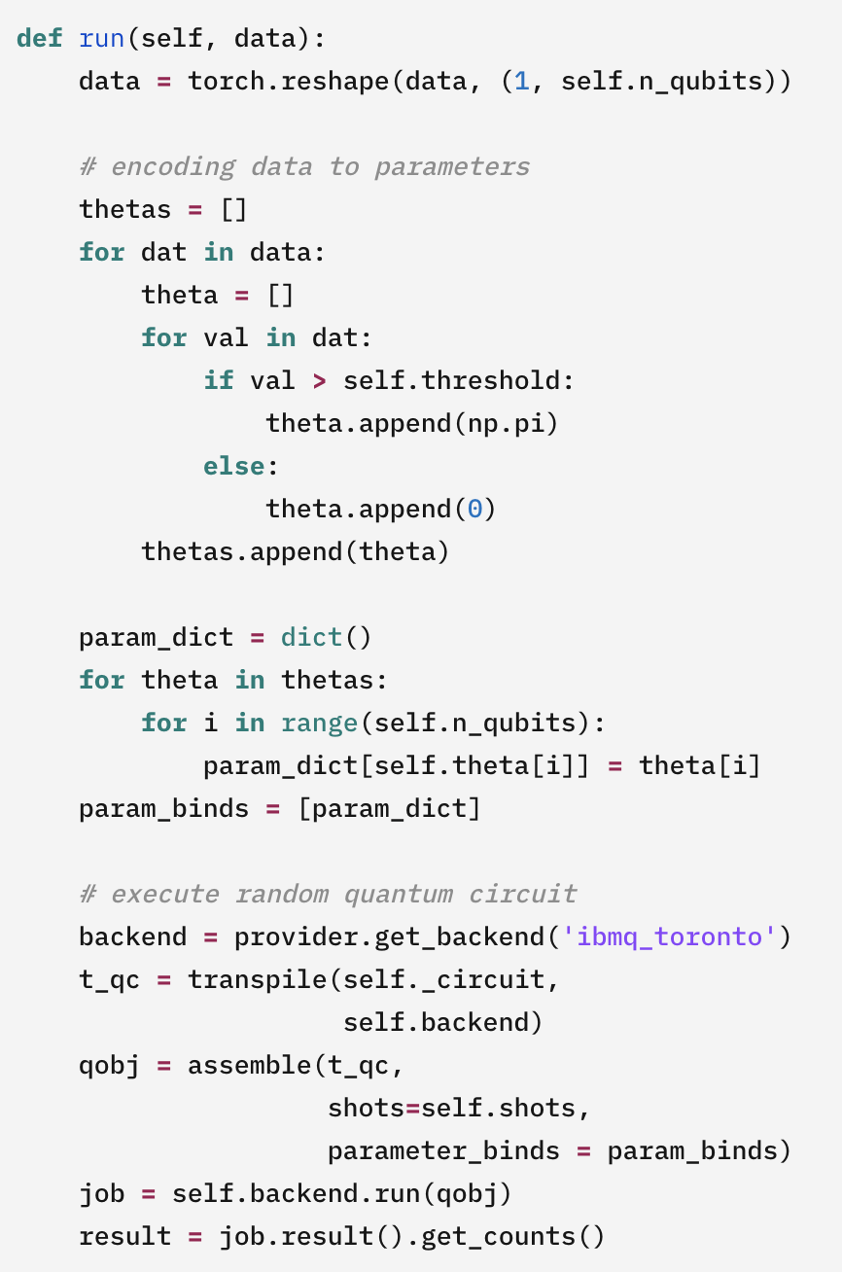
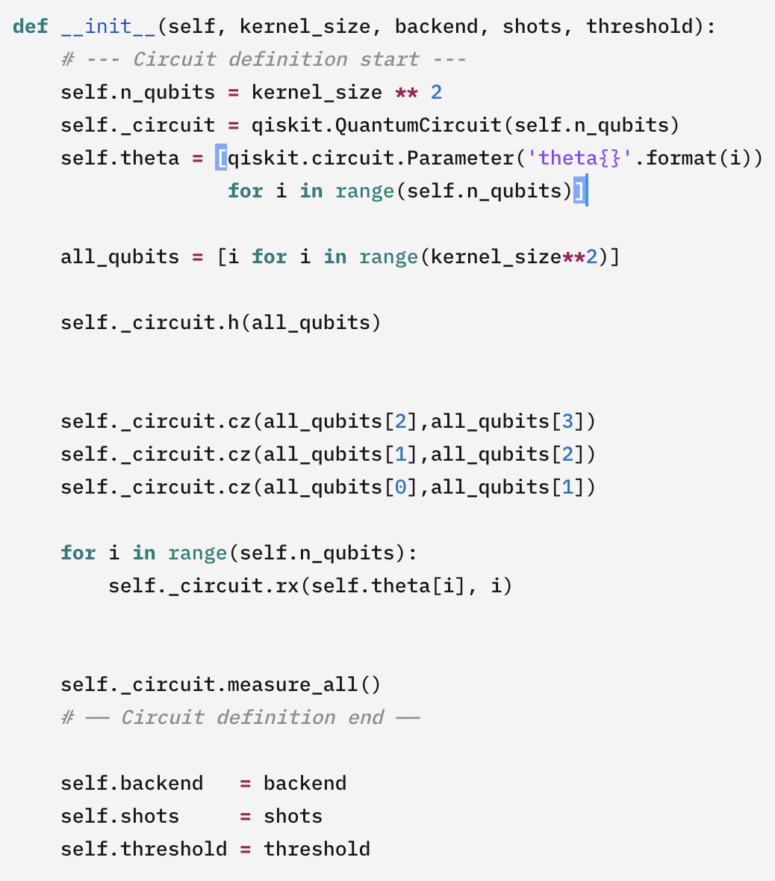
TEXT
Quantum circuit
d
Store the value of classical data as theta for use in quantum circuits.
- Construct a quantum circuit by declaring the number of qubits according to the filter size. → Quantum circuit is used as a filter.
→ i.e. creating a parameterized circuit by setting the theta value as a parameter.
- In the quantum circuit filter, the state of the qubit is calculated by rotating it according to the theta value stored in the data value.

Slide 7
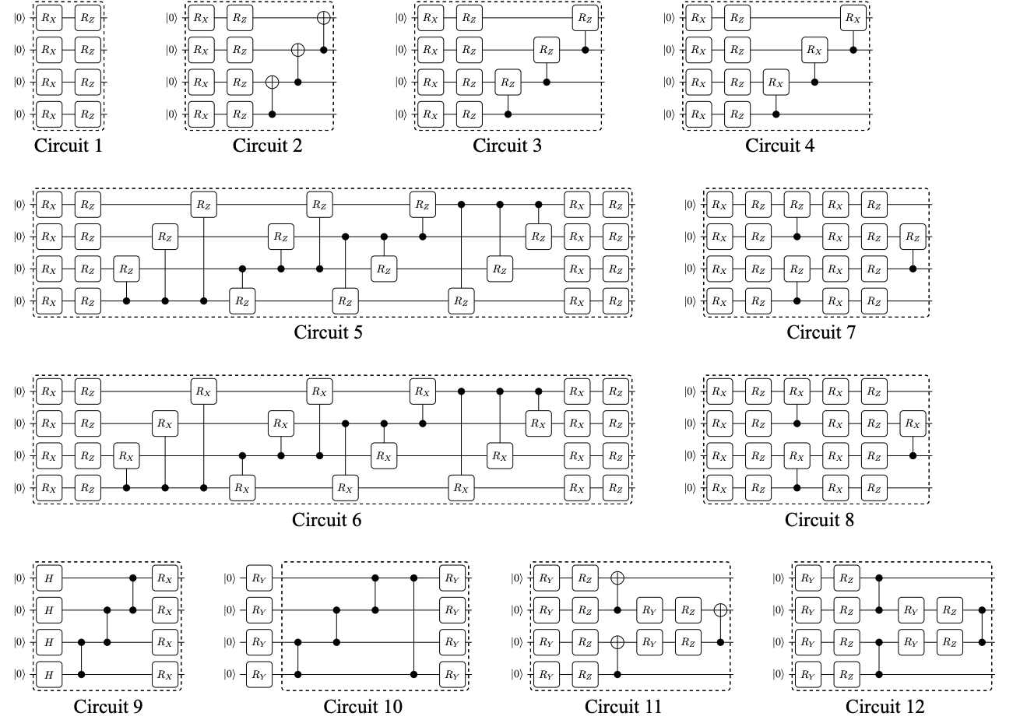
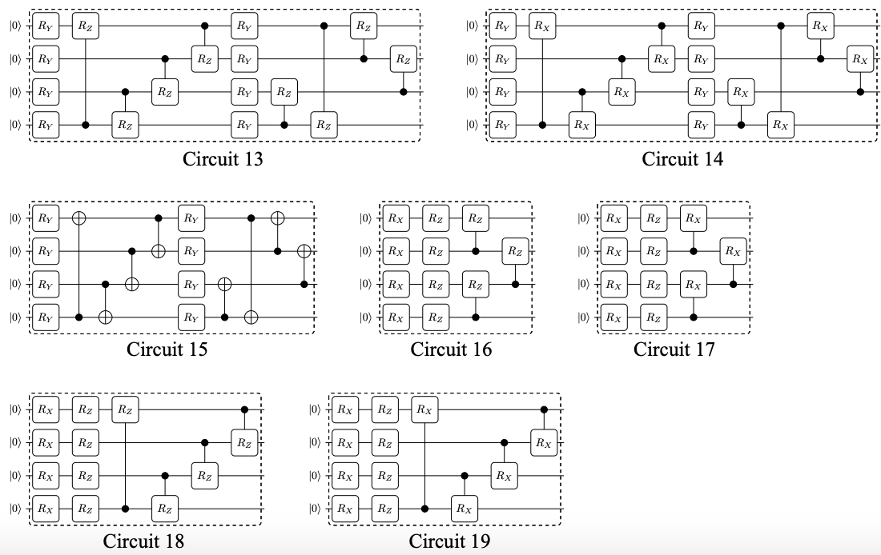
TEXT
Quantum circuit filter
There are various quantum circuit filters, and the accuracy is different for each circuit.
It is important to consider the cost aspect according to depth and parameters, and to use an appropriate quantum circuit filter.

Slide 8
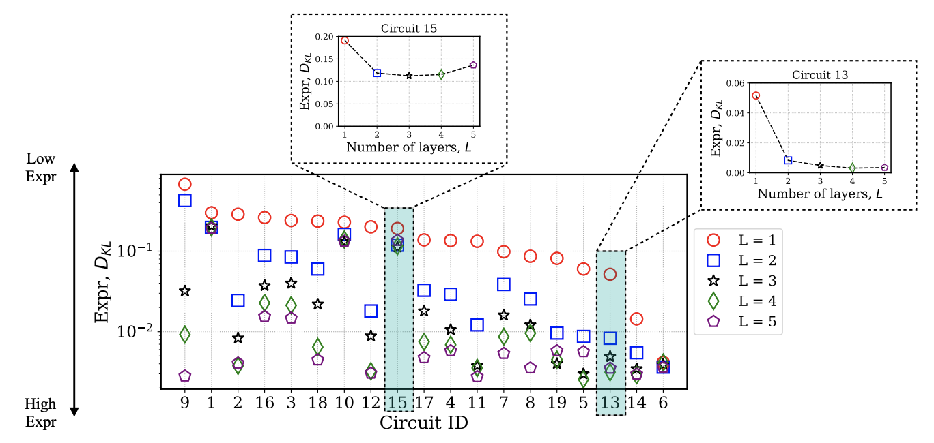
TEXT
Quantum circuit
When L = 1 based on the yellow line (L is the number of layers), it can be seen that the accuracy is similar.
For all circuits, the best performance is when L=1.

Slide 9
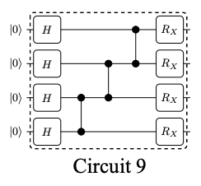
TEXT
Quantum circuit filter
It has the lowest accuracy, but it has a low depth, so it can be calculated with a low gate cost.
It is expected that the gate cost is low because the depth is small, but the accuracy is very low, so it will not play the role of a good filter.

Slide 10
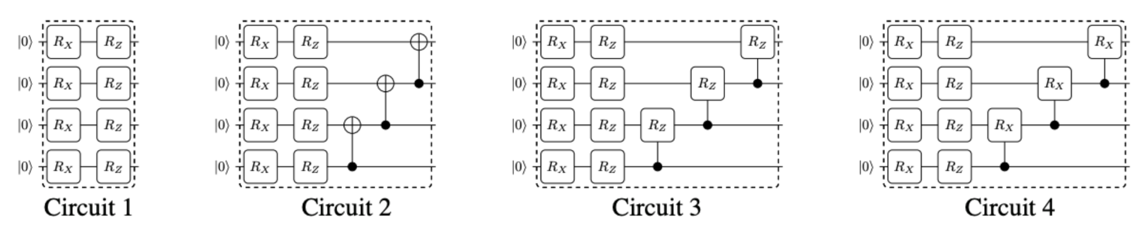
TEXT
Quantum circuit filter
Add CNOT-gate
CNOT → Rz
Rz → Rx
Relatively low accuracy.
The gate cost is not very high because the circuit depth is not deep.
Although the circuit depth is not deep, the gate cost is not high.
It is judged that it is not suitable for use as a filter because the accuracy is not high.

Slide 11
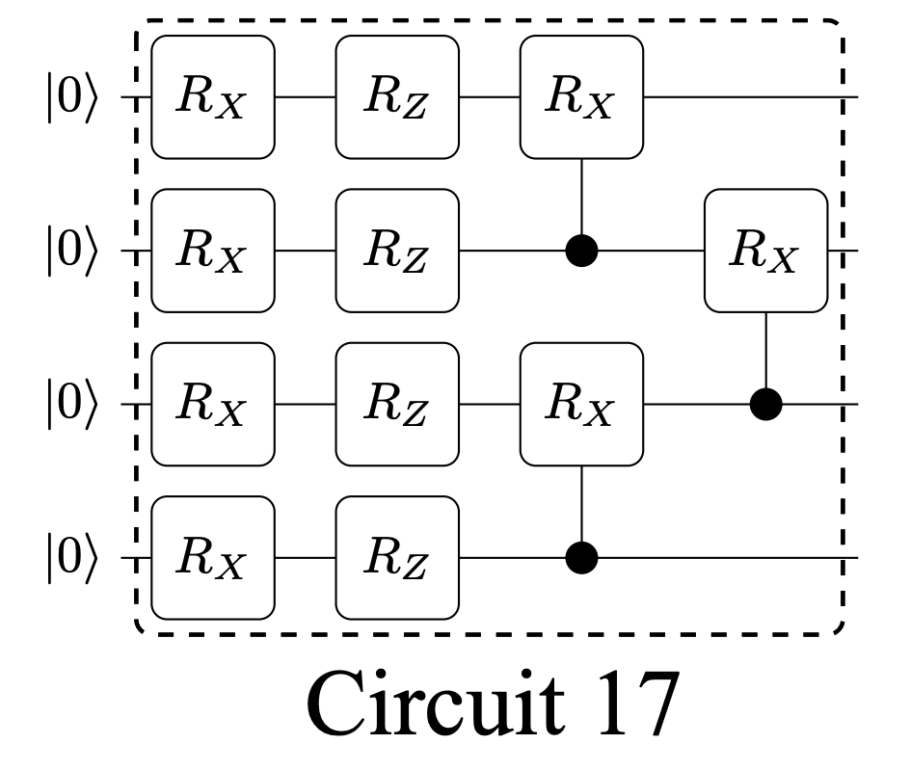
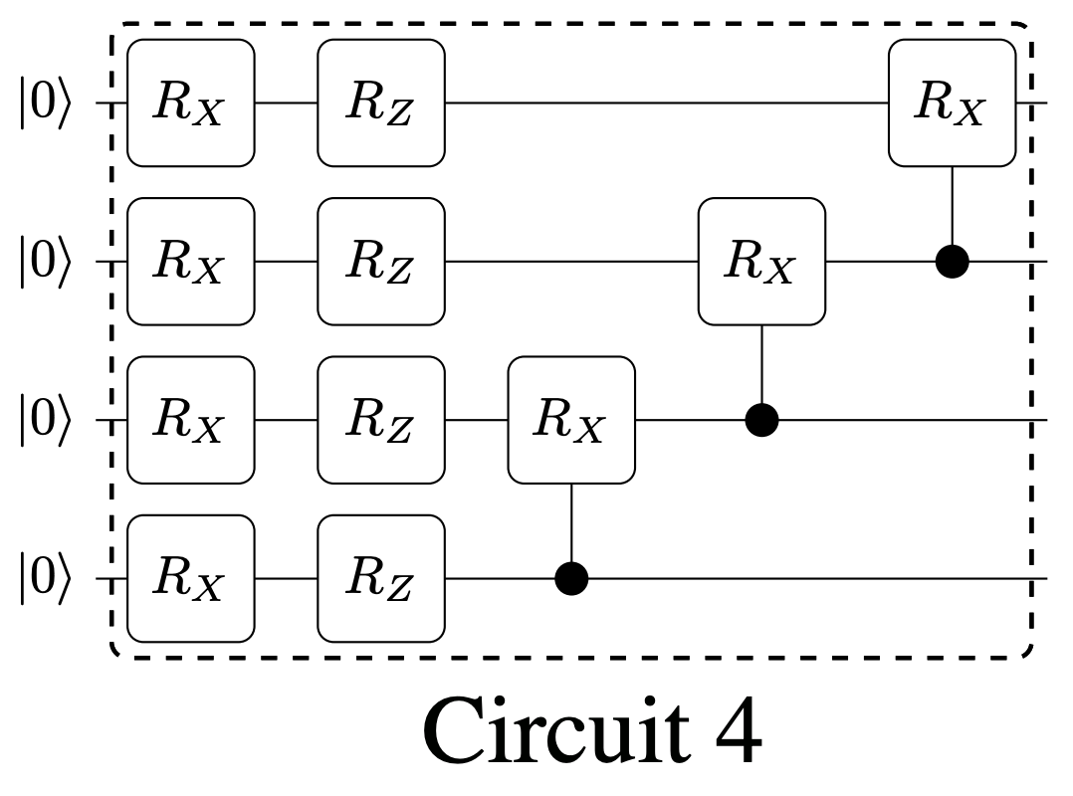
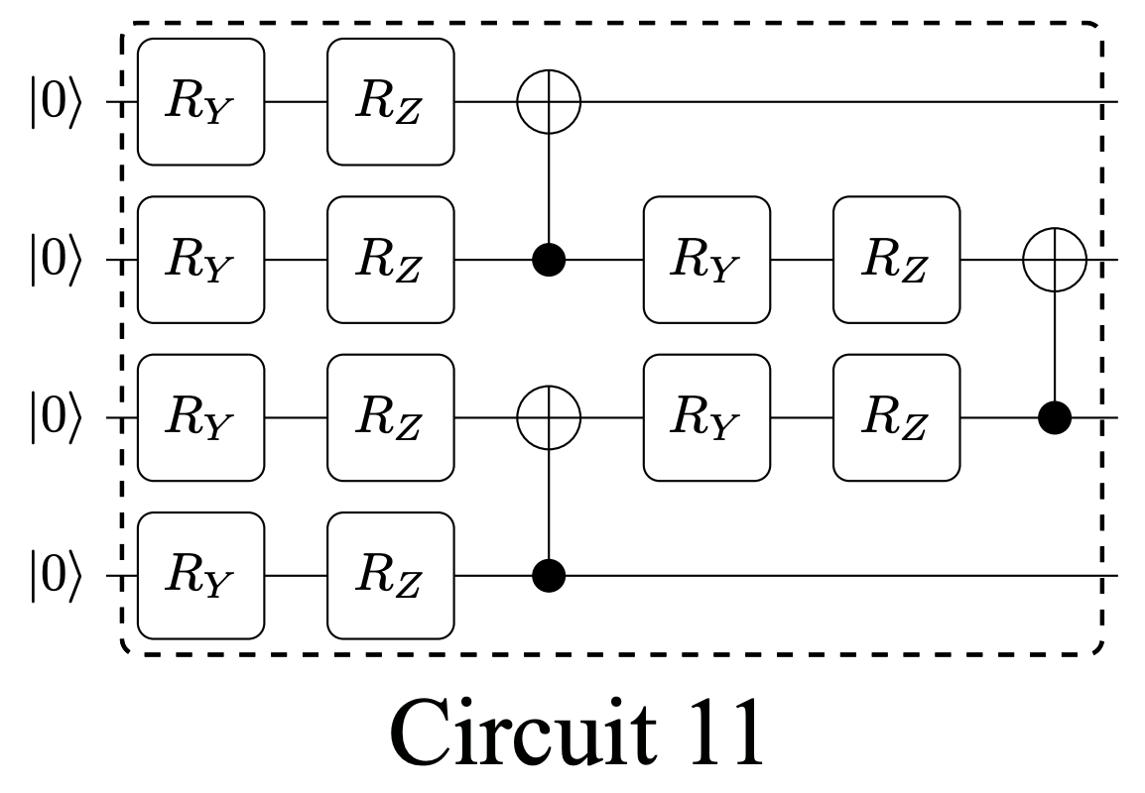
TEXT
Quantum circuit filter
Shows adequate accuracy.
It seems that the depth of the circuit is also appropriate.
It has moderately high accuracy and the depth of the circuit is also suitable, so it does not cost a lot of gate cost, so it is considered suitable for use as a filter.

Slide 12
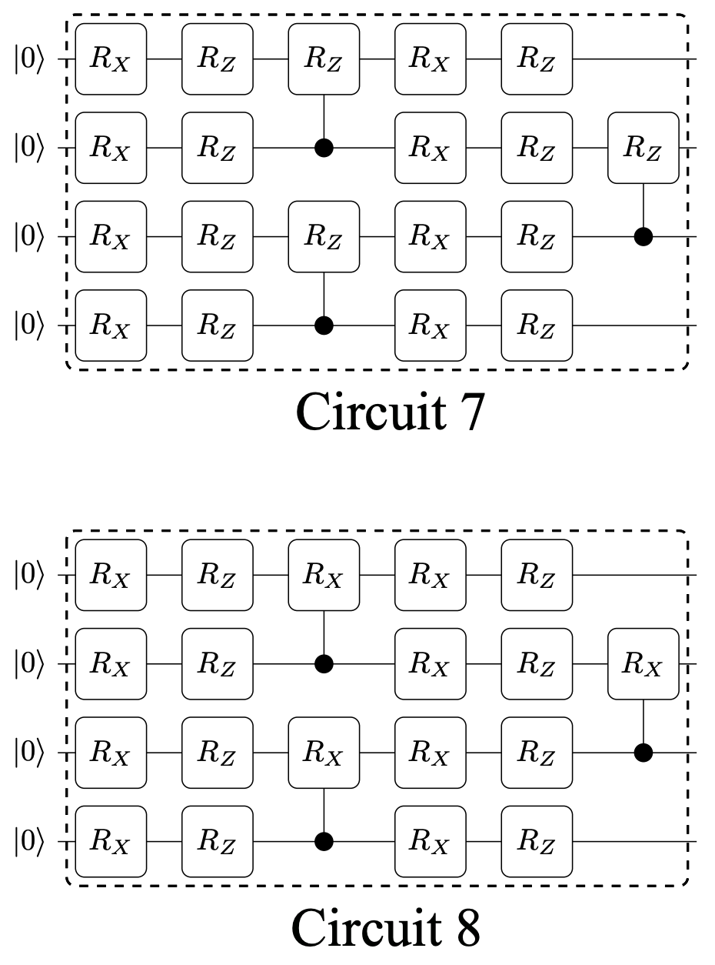
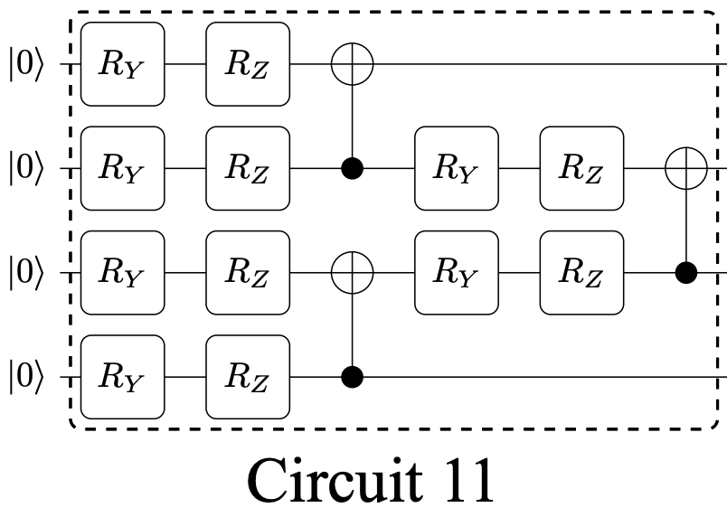
TEXT
Quantum circuit filter
It shows relatively high accuracy.
The gate cost is not very high because the circuit depth is not deep.
It has moderately high accuracy and the circuit depth is not deep, so the gate cost is not too high, so it is good to use as a filter.
Improved accuracy by extended parameterization

Slide 13
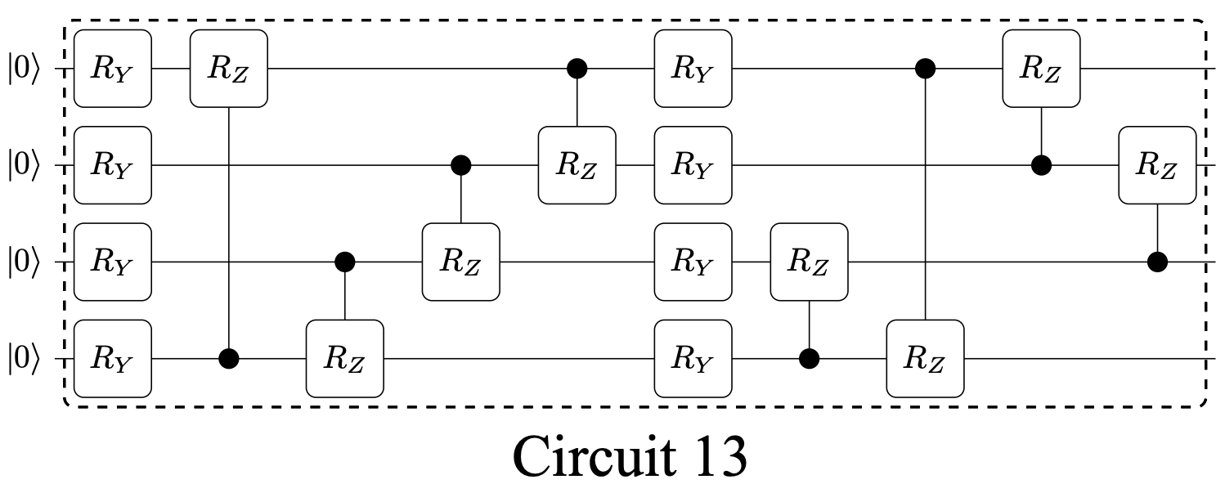
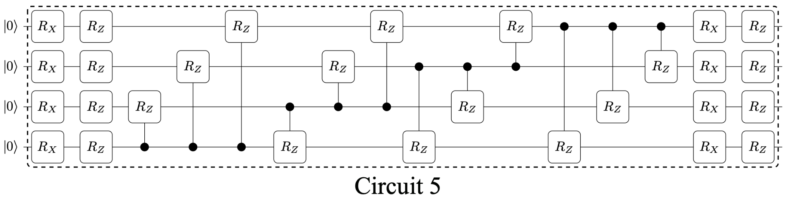
TEXT
Quantum circuit filter
Both Circuit 5 and Circuit 13 showed high accuracy. Circuit 5 shows lower accuracy than Circuit 13 despite using a lot of gate cost according to the deeper depth than Circuit 13.
so using circuit 13 will be much more effective.

Slide 14
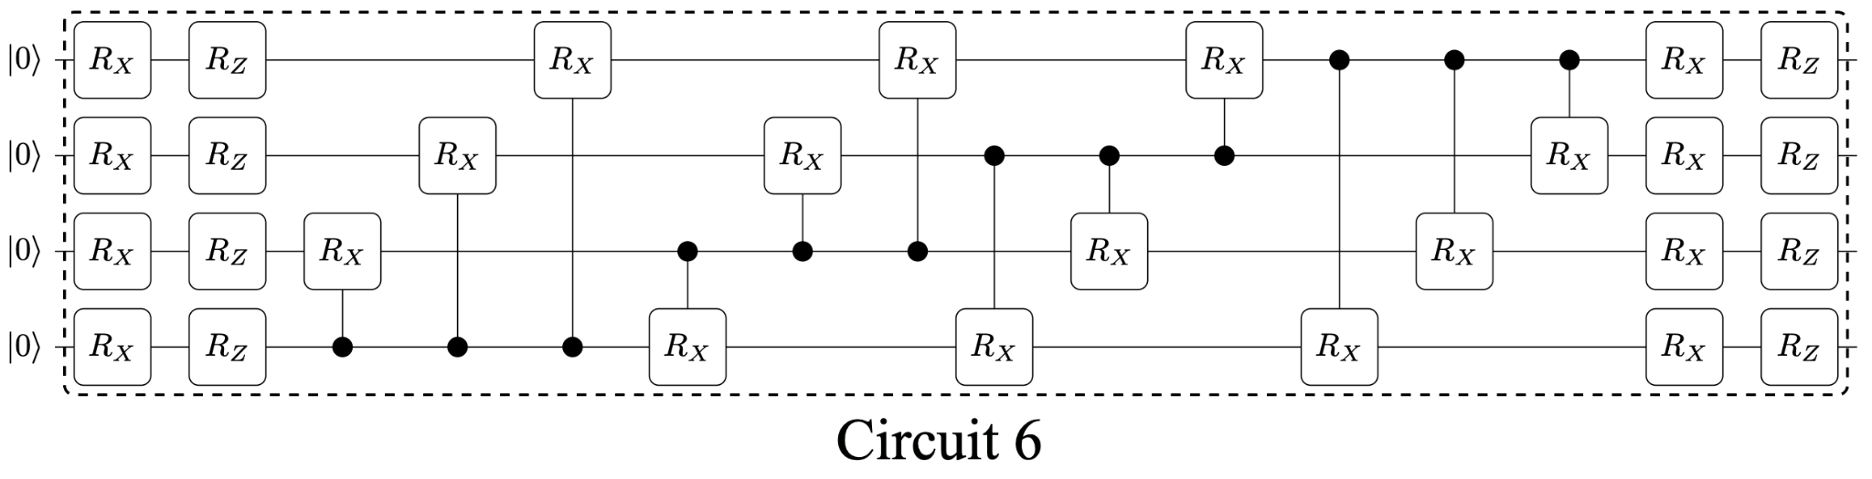
TEXT
Quantum circuit filter
It shows the highest accuracy among quantum filters.
Due to the deep circuit depth, a lot of gate cost is consumed.
Although it has high accuracy, it consumes a lot of gate cost due to its deep depth. It is judged that it is more appropriate to use a filter with a slightly lower accuracy and a lower gate cost.

Slide 15
TEXT
Select the quantum circuit filter
Select Circuit 6, Circuit 8, Circuit 9, Circuit 11, Circuit 13 among the proposed 19 quantum filters.
The reason why we selected these filters:
-Circuit 6 : Since the highest accuracy was achieved, it is suitable for comparison with other circuits.
-Circuit 8 : Relatively high accuracy was achieved by modifying Circuit 11 to improve accuracy.
It is appropriate to check the improvement through comparison with circuit 11.
-Circuit 11 : Comparison with circuit 8
-Circuit 9 : Since the lowest accuracy was achieved, it is suitable for comparison with other circuits.
-Circuit 13 : It is judged as a circuit that properly maintains the circuit depth and accuracy, so it is considered the most suitable for use as a filter

Slide 16
TEXT
Implementation of the quantum circuit filter
We implemented the circuits, and apply to hybid neural networks.

Slide 17
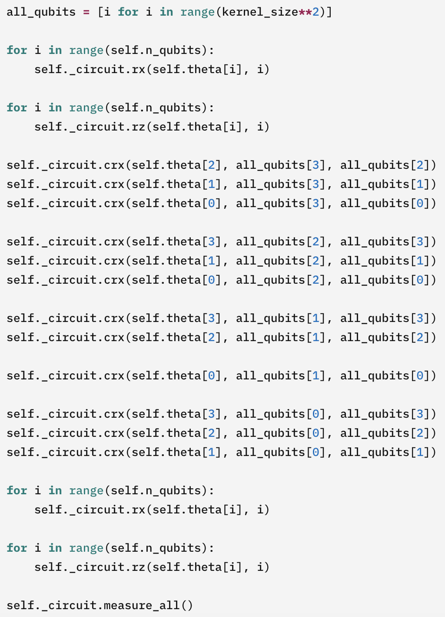
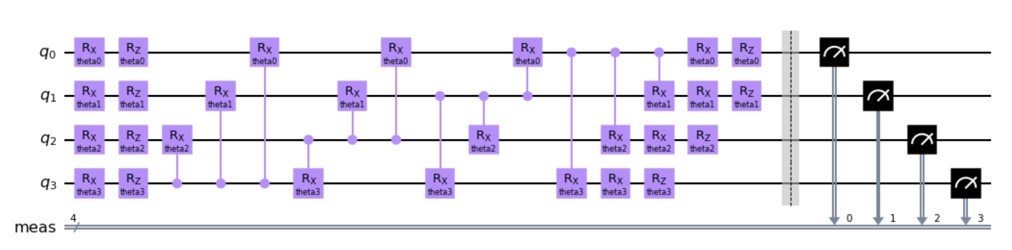
TEXT
Quantum circuit filter $6$

Slide 18
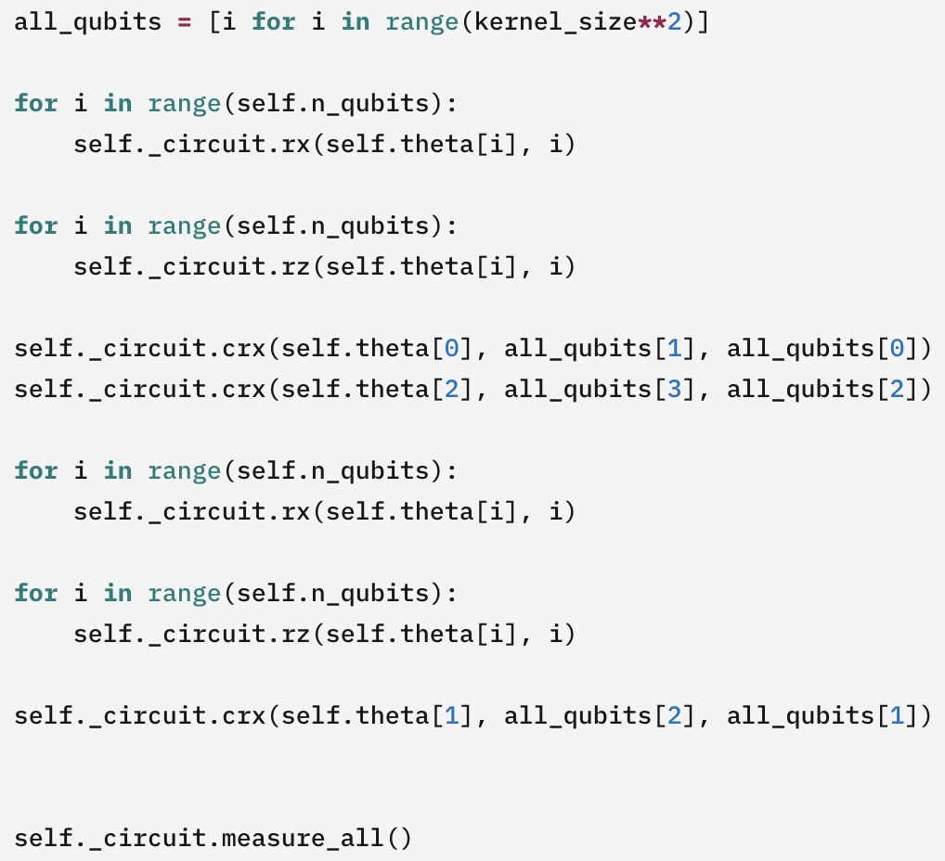
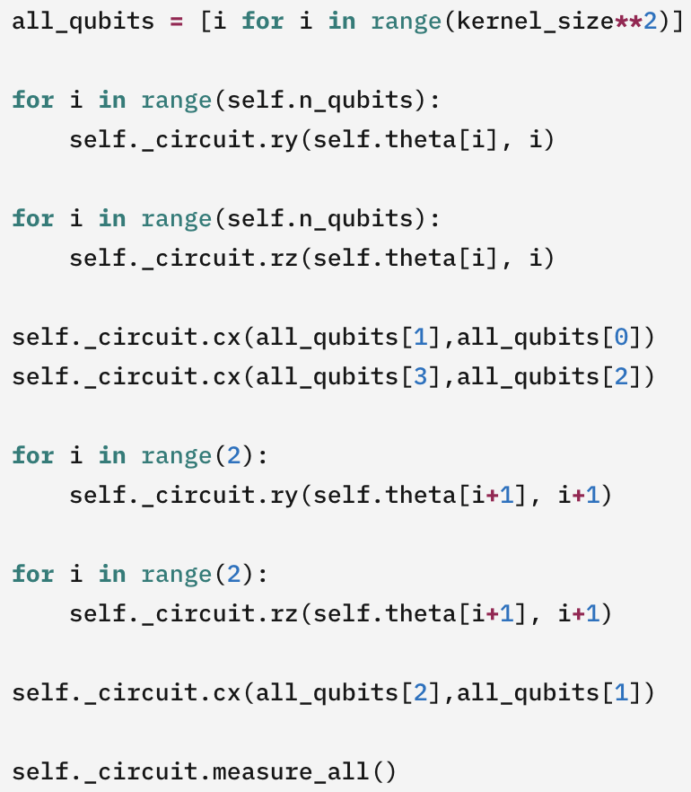
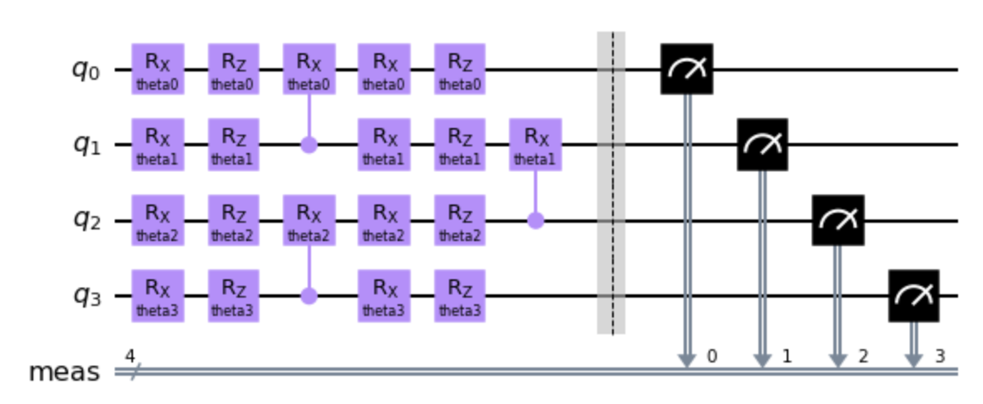
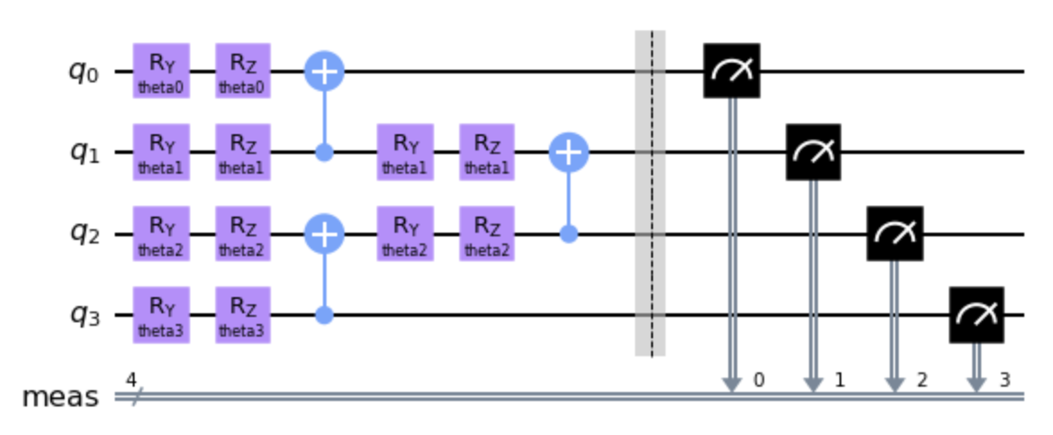
TEXT
Quantum circuit filter $8, 11$
Circuit 8
Circuit 11

Slide 19
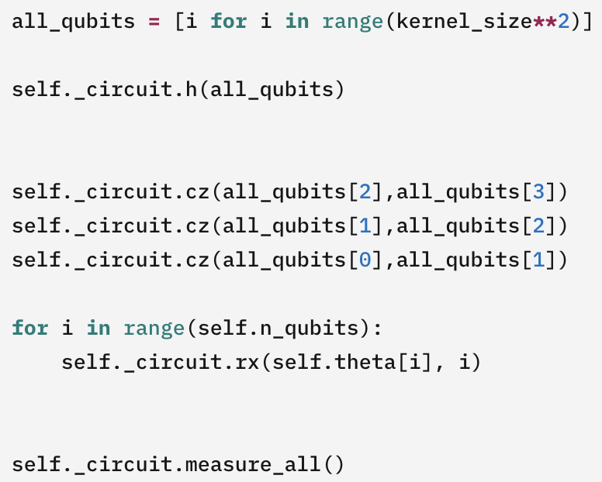
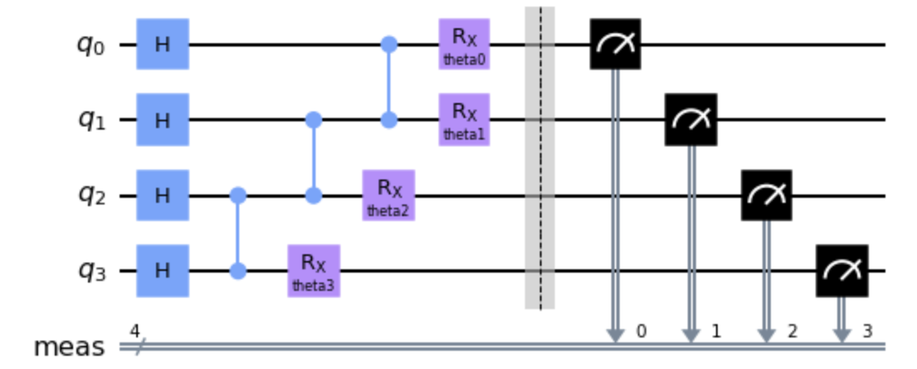
TEXT
Quantum circuit filter $9$

Slide 20
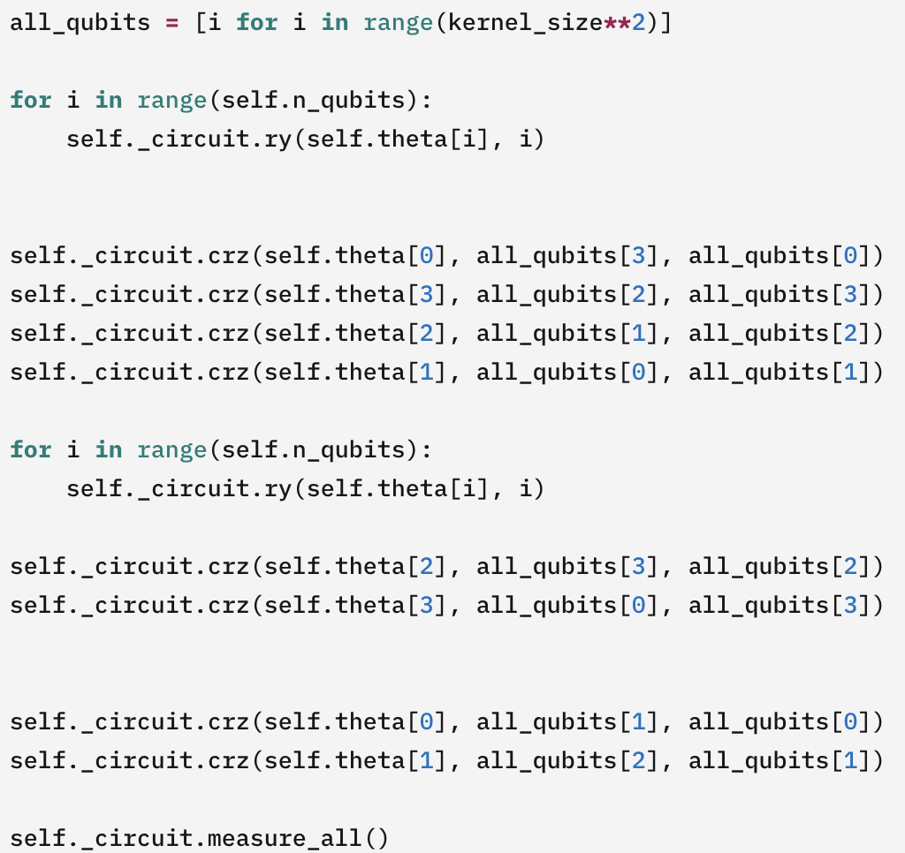
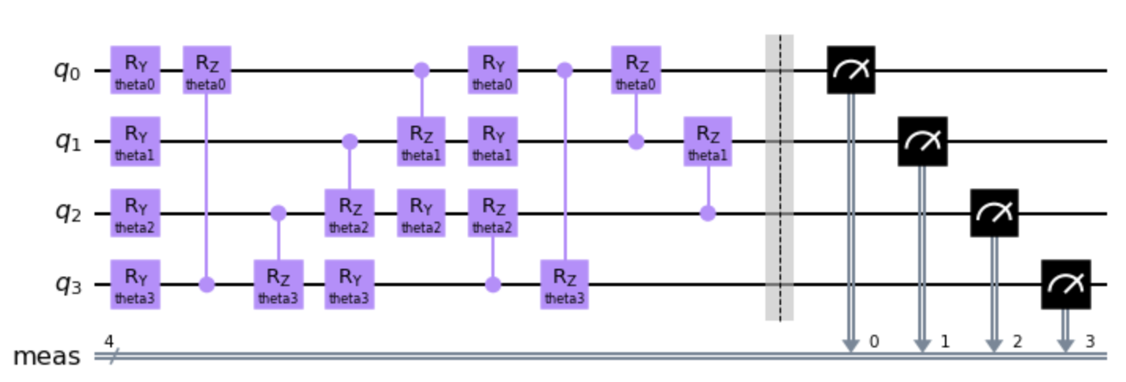
TEXT
Quantum circuit $13$

Slide 21
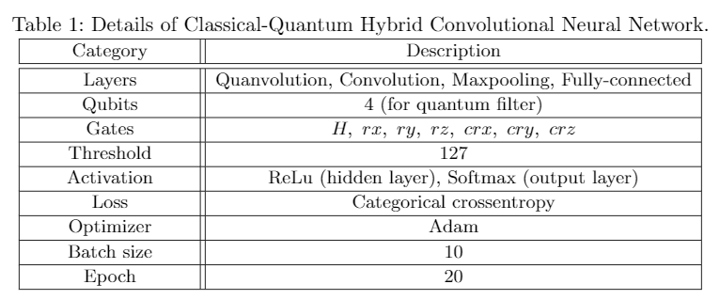
TEXT
Hybrid neural network
Quantum circuit + Classical neural network
Classical neural network
Layers Convolution-2D and maxpooling-2D layer : Feature extraction and enhancement of input data Fully-connected layer : unit of output layer is 10 (the number of label)
Categorical cross entropy loss function multiclass classification → Categorical
Activation function hidden layer → relu (fast) output layer → softmax (multiclass classification)
Adam optimizer generally good performance

Slide 22
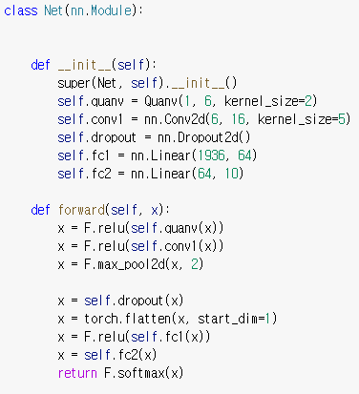
TEXT
Parameter update in hybrid neural network
Training process Same as the existing training process (Except that the input data is the output of the quantum circuit) - The entire data is input in batch units, and it repeats as many as epochs. - forward → calculate loss → backward propagation → parameter update
Update both the parameters of quantum circuits and classical neural networks → Quantum circuits are used as layers, and the whole works like a single neural network.

Slide 23
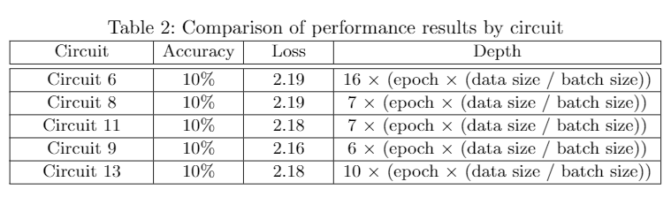
TEXT
Compare the classification performance
Result of running the hybrid neural network Running with the real quantum hardware → too slow to check the result Running with the simulator → faster than real hardware but still slow → We couldn't experiment with applying various hyper-parameters.
The execution time was too long, so we reduced the data, but training is not performed (too small dataset).
As shown in this table, the circuit depth is affected by the epoch, batch size and data size. And depth affect the execution time.

Slide 24
TEXT
Conclusion
Quantum backend
Running with real quantum hardware, it is too slow to check the result. Running with simulator, it was very slow, We couldn't experiment with applying various hyper-parameters.
In quantum circuits, in order to obtain accurate results, the circuit must be repeated several times when it is performed once, and repeated execution is repeated due to the batch unit training of neural networks.
Kernel size can be set as many as the number of qubits supported by quantum hardware → In general, classical neural networks perform better with more kernels. → If the quantum hardware that supports more qubits is used, performance is expected to improve.
Quantum Circuit
There are various quantum circuit filters and each circuit produces different accuracy.
Need to consider the cost and accuracy according to the depth and parameters of the circuit. Need to select the circuit design considering the number of supported qubits and accuracy. → Design a suitable quantum circuit (for filter in hybrid neural network)

Slide 25
Thank you for your attention

